Slide 1
Disney
Strategic Analysis
Team 1: Yuxuan Chen, Radhey Patel, Sikta Samal, Manuel Sobol, Greg Valerius, Angela Vellante
Notes:
Sikta

Slide 2
AGENDA
01
02
ABOUT DISNEY
INDUSTRY ANALYSIS
03
DISNEY’S STRATEGY & POSITIONING
04
RECOMMENDATIONS
Notes:
Sikta

Slide 3
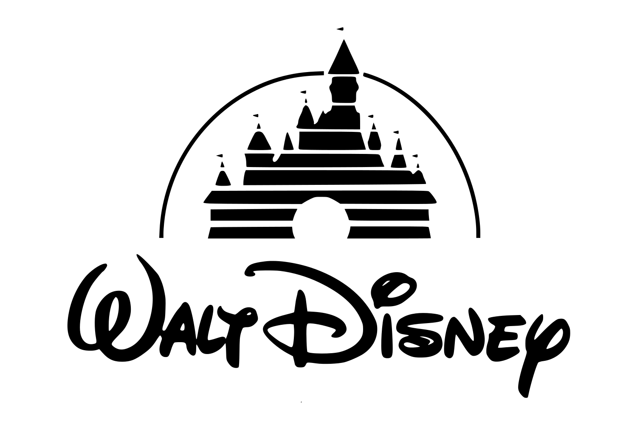
Disney’s Has A Unique Position As A Diversified Entertainment Conglomerate
Pandemic has had major impact on Disney's financials: net income fell 99% in Q1 of 2021 and revenue for the quarter fell by 22% ﻿﻿
Most adverse impact of the pandemic was felt in its Parks and Experiences segment
In 2021, Disney reorganized business segments into Disney Media and Entertainment Distribution and Disney Parks, Experiences and Products
Launched Disney+ under DMED division; emerged as champion among its offerings
Notes:
Sikta

Slide 4
INDUSTRY ANALYSIS
Notes:
Sikta-Greg

Slide 5
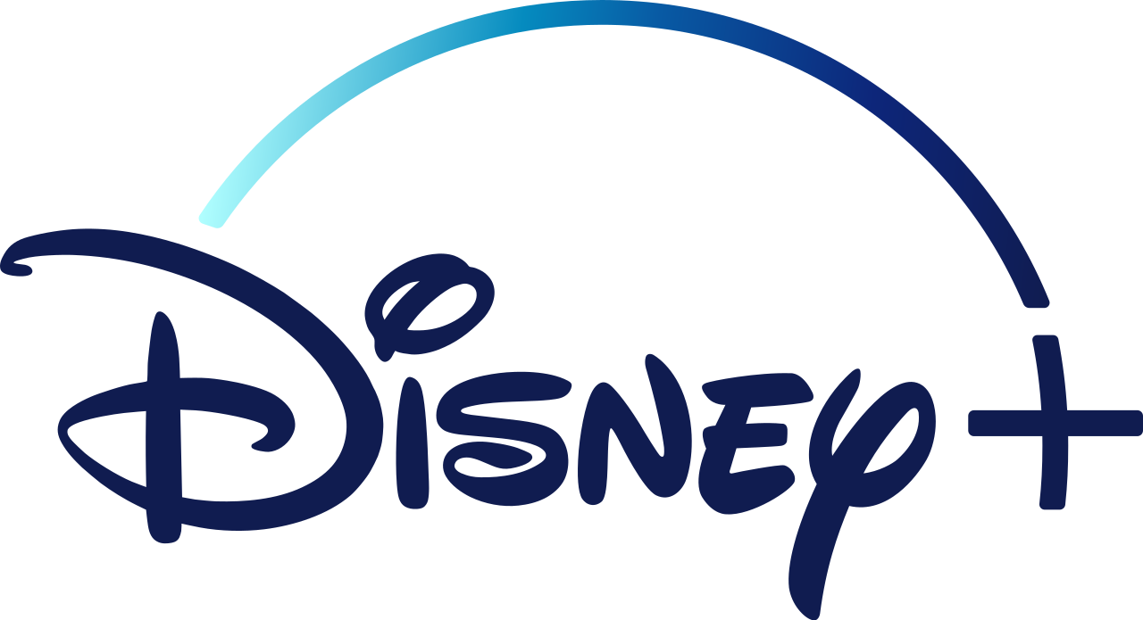
The Streaming Services Industry Is Attractive And Presents Opportunities For Incumbents
Rivalry
Top four providers make up over 75% of the industry
Industry is projected to grow 23.2% in next 5 years
Threat of Entry
High economies of scale and capital requirements
Likely only possible for larger firms with necessary resources
Supplier Power
Firms with own production studios have low threat
Trend towards original content diminishes power
Threat of Substitutes
Increase in cord cutting and decrease in popularity of movie theaters
Price to value trade off due to unlimited access to variety of content
Buyer Power
High due to low switching costs
Content differentiation is key
Notes:
Greg

Slide 6
DISNEY’S STRATEGY & POSITIONING
Notes:
-Radhey

Slide 7
Disney+ Can Use Its Strengths To Overcome Potential Threats And Weaknesses
- Ownership of Disney’s IP and exclusive content library - Established household brand with loyal fanbase
- Niche Content Identity
- Restrictive Target Market
S
W
O
T
- Acquisitions to expand content library and diversify
- Expanding on to other tech-entertainment arena
- Mobilizing fan base using network effects
- Competition for screen time
- Parents’ aversion to technology
- Privacy and ad regulations
- Piracy and malicious actors
Notes:
Radhey- Disney’s Core strength is leveraging entertainment IP for business success. Over decades, the Disney’s mission to align itself as the entertainment company has created a loyal fanbase as well as turning itself into a household name synonymous with family friendly content. Despite its reputation as a family oriented company, recent acquisitions have provided a diversification of their identity, let alone revenue streams. Disney’s and, by extension, Disney+ currently face multiple contenders in the field of entertainment, competing for screen time. This can be leveraged to expand into positioning themselves in a different geographical markets as well as the techno-entertainment arena.

Slide 8
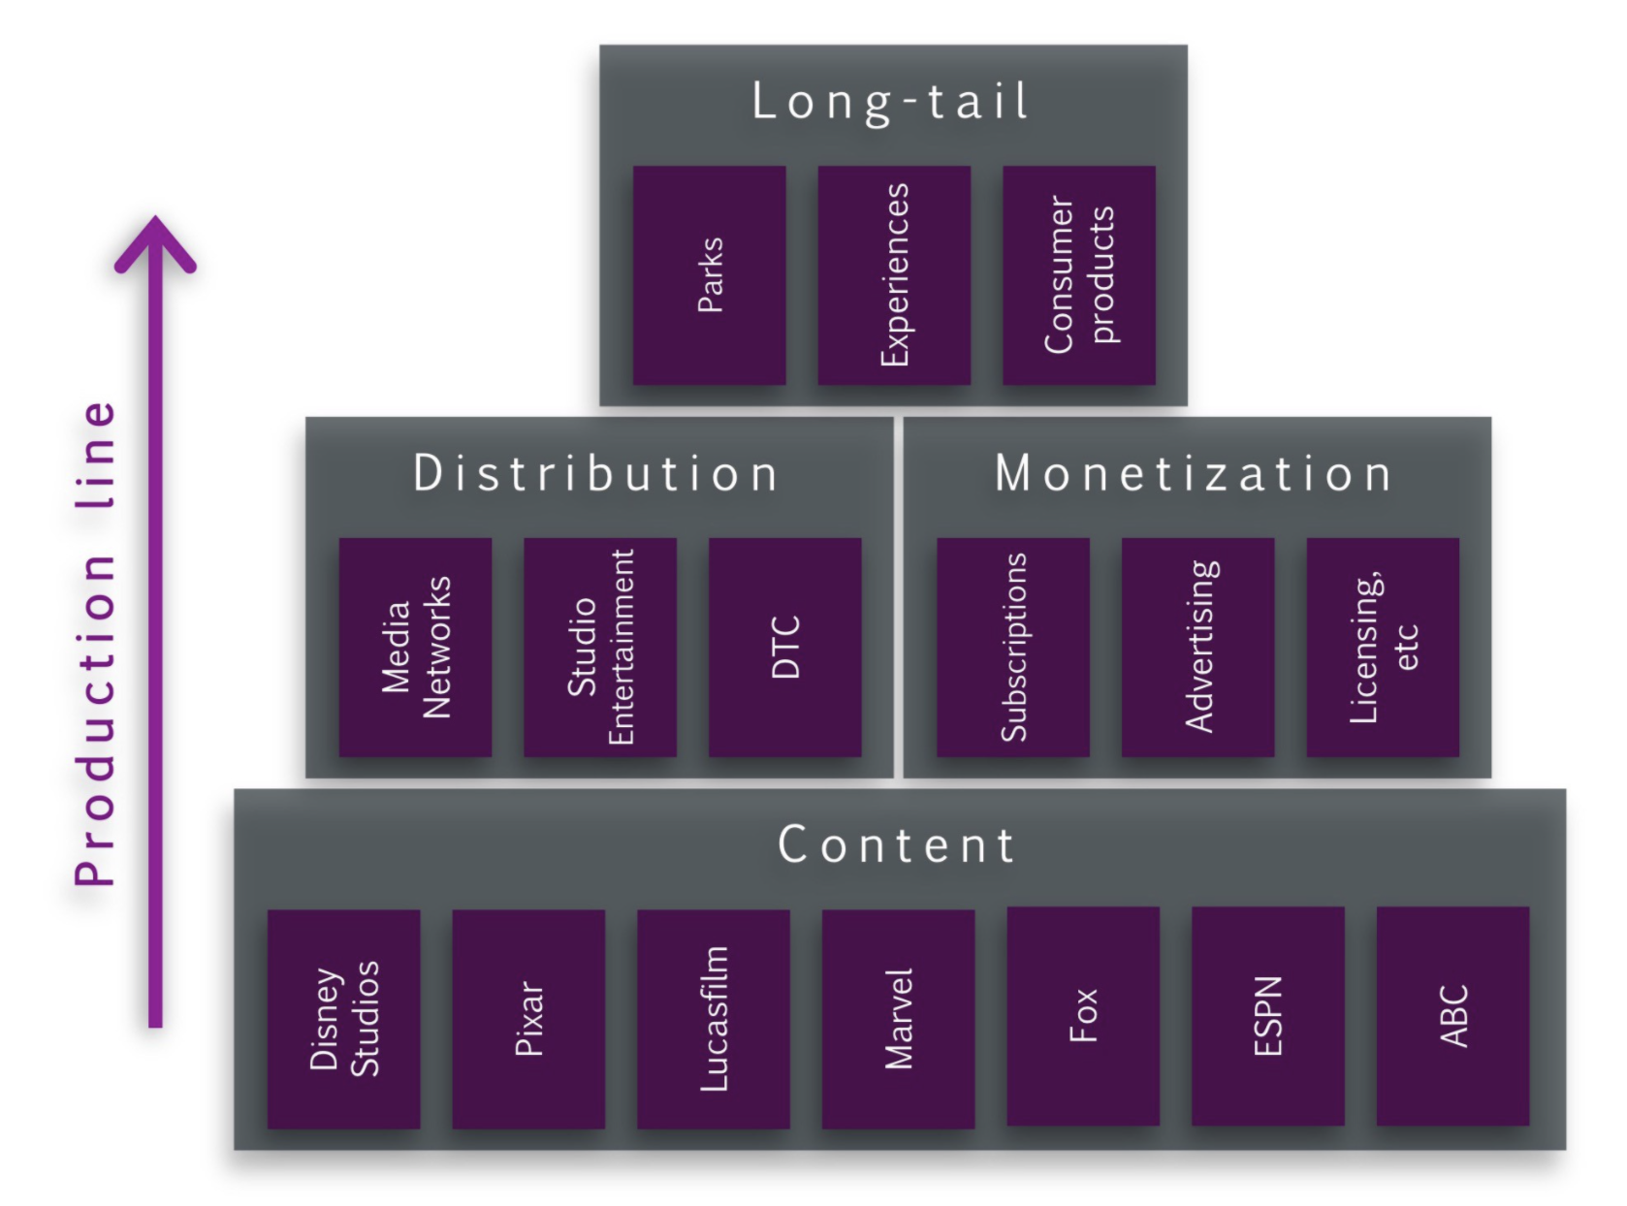
Disney’s Operational Aspects
Content creation groups
Studios
General entertainment
Sports
Media & Entertainment Distribution segment
Global distribution
Commercialization
Notes:
Angela

Slide 9
Disney Has A Sustainable Advantage And Is Well Positioned For The Future
Product Differentiation
Creativity & Innovation
Integration of Segments
Notes:
Angela

Slide 10
RECOMMENDATIONS
Notes:
Manuel

Slide 11
Disney and Disney+’s Future Involves A Focus On Video Game Development, VR, And Social Elements
Larger market
Increase brand popularity
Engaging/interactive
Video game development
Potentially disruptive technology
Increase customer engagement
Partner with Sony
VR games/movies with exclusive content
Alternative to movie theater showing
Virtual reality
Video chat capabilities
Virtual premiers
Disney Game
Introducing social elements to Disney+
Notes:
Manuel- Ethan

Slide 12
THANK YOU
Questions?

